Slide 1
WorkshopPLUS Power Platform for Administrators
Application Lifecyle Management
Notes:
Workshop Version: 2.6

Slide 2
Conditions and terms of use
© Microsoft Corporation. All rights reserved.
You may use these training materials solely for your personal internal reference and non-commercial purposes. You may not distribute, transmit, resell or otherwise make these training materials available to any other person or party without express permission from Microsoft Corporation. URL’s or other internet website references in the training materials may change without notice. Unless otherwise noted, any companies, organizations, domain names, e-mail addresses, people, places and events depicted in the training materials are for illustration only and are fictitious. No real association is intended or inferred. THESE TRAINING MATERIALS ARE PROVIDED “AS IS”; MICROSOFT MAKES NO WARRANTIES, EXPRESS OR IMPLIED IN THESE TRAINING MATERIALS

Slide 3

Objectives
After completing this Learning, you will be able to:
 | 1 | Understand…. Basic concepts about Application Lifecycle Management (ALM)
 | 2 | Understand…. How to export/import Apps and Flows using packages
 | 3 | Understand…. What Power Platform Solutions are How to deploy resources using solutions How to setup out of the box Power Platform Pipelines and how these work
 | 4 | Understand…. What Power Platform Build Tools for Azure DevOps are What GitHub actions for Power Platform are

Slide 4
Understand Power Platform ALM

Slide 5
What is ALM?
Lifecycle management of applications, which includes governance, development and maintenance
Includes topics and tasks like:
Project, change and requirements management | Maintenance
Software architecture | Continuous Integration (CI)
Development | Continuous Deployment (CD)
Testing | Release management
ALM tools provide a standardized system for communication and collaboration between software development teams and related departments, such as test and operations. These tools can also automate the process of software development and delivery.
Microsoft Confidential

Slide 6
Key areas of ALM
Governance includes requirements management, resource management, data security, user access, change tracking, review, audit, deployment control, and rollback.
Application development includes identifying current problems, and planning, design, building, and testing the application. This area includes traditional developer and app maker roles.
Maintenance includes deployment of the app and maintenance of optional and dependent technologies.
Microsoft Confidential

Slide 7
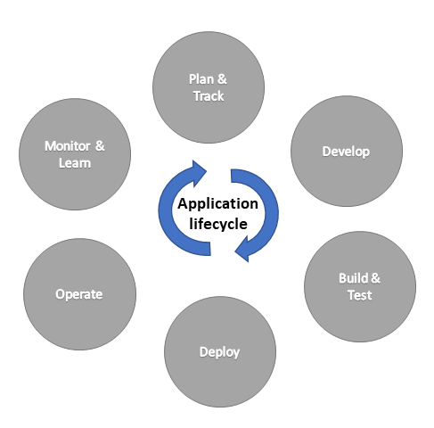
Cyclical development process
The application lifecycle is the cyclical software development process that involves these areas.
Microsoft Confidential

Slide 8
ALM for Power Platform
Dataverse lets you securely store and manage data that's used by business applications.
To use the features and tools available for ALM, all environments that participate in ALM must include a Dataverse database.
The following concepts are important for understanding ALM using the Microsoft Power Platform:
Solutions are the mechanism for implementing ALM which you use to distribute components across environments through export and import.
Dataverse stores all the artifacts, including solutions.
Components (inside solutions) such as apps, flows, tables, site maps etc. represents something that you can potentially customize
Source control should be your source of truth for storing and collaborating on your components.
Microsoft Confidential

Slide 9
Types of environments used in ALM
Sandbox environment is any non-production environment of Dataverse and is the place where you can safely develop and test application changes with low risk. Sandbox environments include capabilities that would be harmful in a production environment, such as reset, delete, and copy operations.
Production is environment where apps and other software are put into operation for their intended use.
Development (Developer Plan) a single-user environment primarily meant for learning purposes giving access to premium functionality of Power Apps, Power Automate, and Dataverse. Although you can't share assets from this environment, you can participate in the Azure DevOps pipeline.
Microsoft Confidential

Slide 10
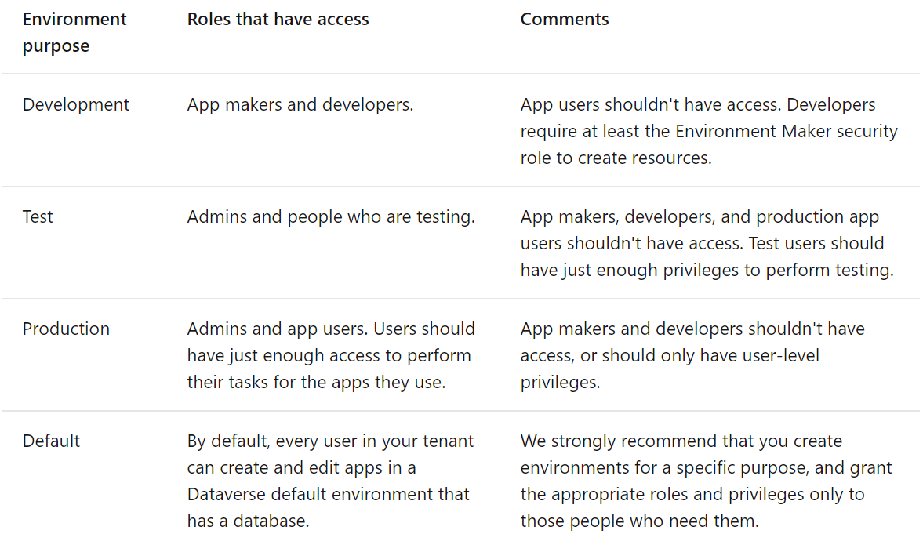
Who should have access?
Microsoft Confidential

Slide 11
Deploy Resources using a Package

Slide 12
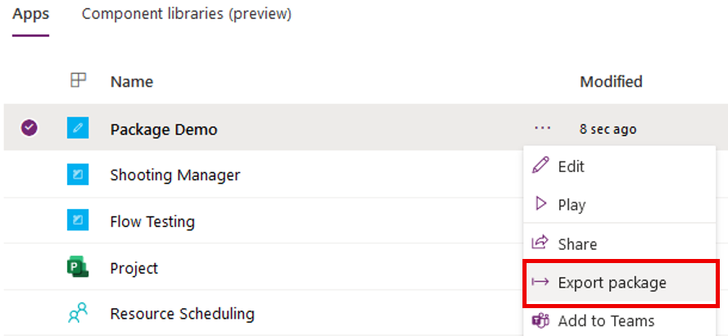
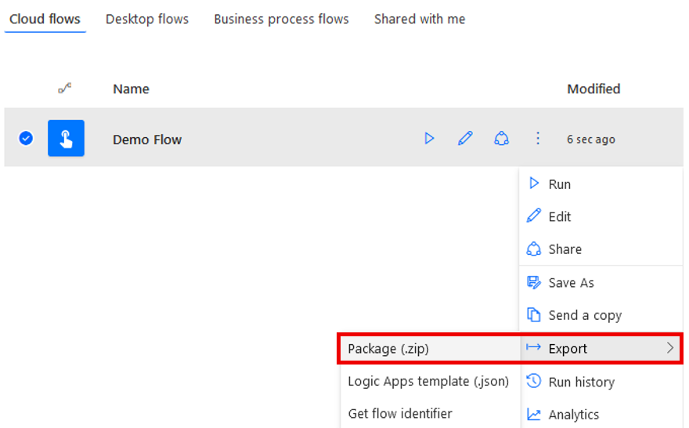
Power Platform Packages
You can deploy (export/import) canvas apps and flows by using packages.
This feature allows you to export an app from one environment and import it to another.
Only the Owners of an app or flow can export a package.
To import an app or flow, the Environment Maker permission is required on the destination environment.
Microsoft Confidential

Slide 13
Which resources can be deployed using a package
Resource type | Supported | Import options
App | Yes (canvas apps) | There are two options to import an app into an environment: Create new and Update
Power Automate | Yes | There are two options to import a flow into an environment: Create new and Update Note: All resources that the flow depends on will also be included within the app package that is exported and will need to be configured when the package is imported.
Custom Connectors | No | Not supported. You'll need to re-create the custom connector on the target environment.
Connections | No | Not supported. You'll need to re-create the connections on the target environment.
Dataverse Customizations | No | Exporting Dataverse customizations as a part of a canvas app / flow package isn't supported. You'll need to use Dataverse solutions instead.
Gateways | No | Not supported. You'll need to re-create the on-premise gateway on the target environment.
Microsoft Confidential

Slide 14
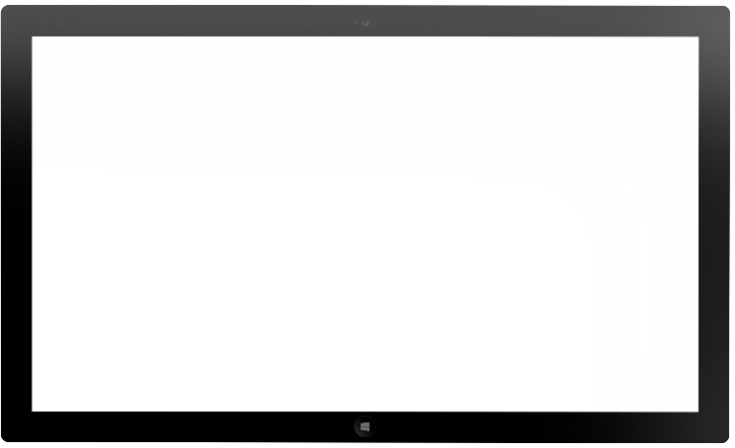
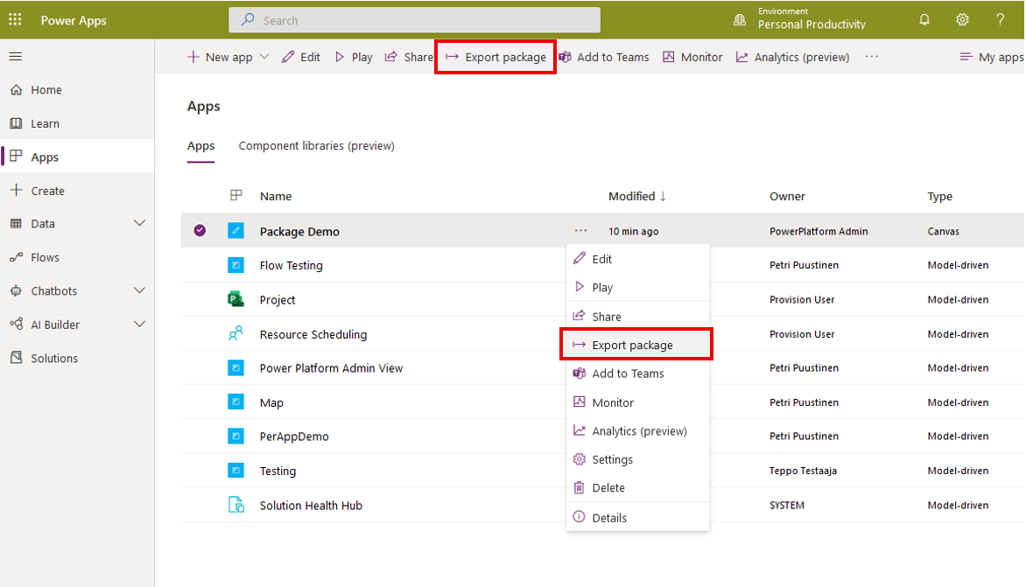
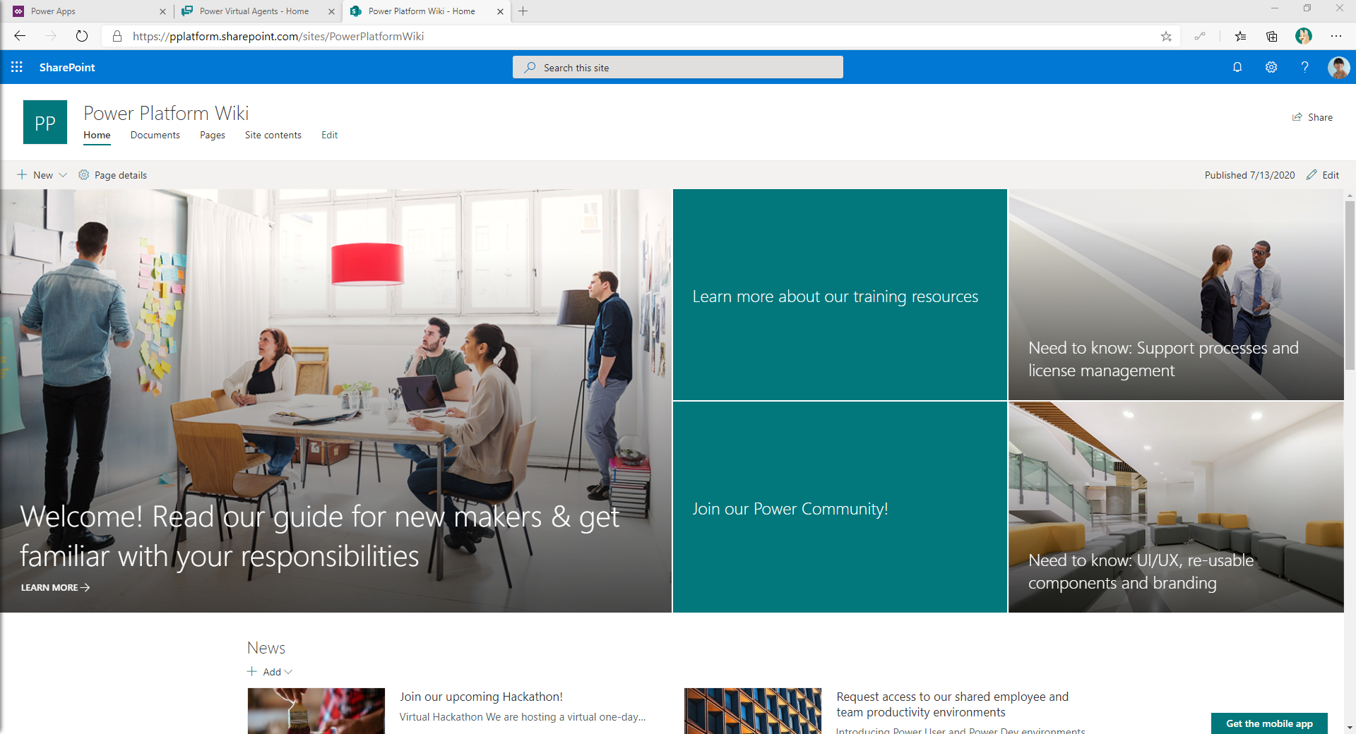
Package Export
1
Select Export package for an App you want to export
Microsoft Confidential

Slide 15
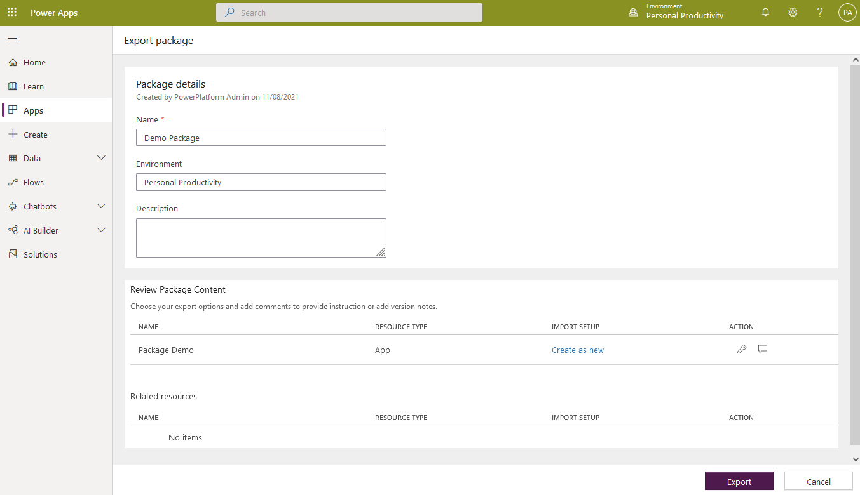
Package Export
1
Select Export package for an App you want to export
2
Define Name, Description and import setup action (create as new / update) for all resources and click Export
Microsoft Confidential

Slide 16
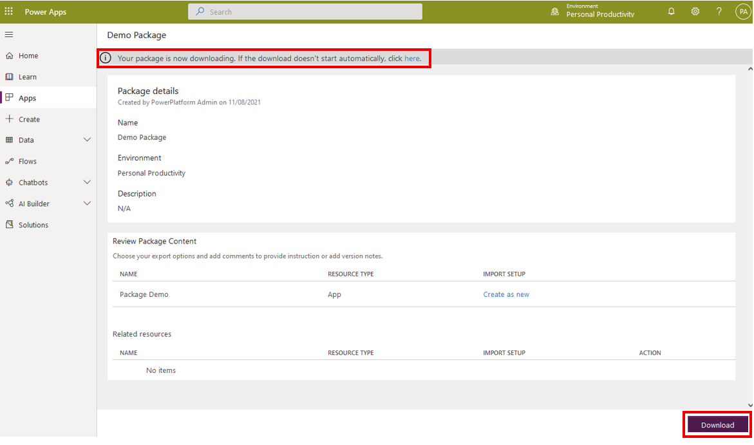
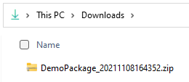
Package Export
1
Select Export package for an App you want to export
2
Define Name, Description and import setup action (create as new / update) for all resources and click Export
3
Package is downloaded a ZIP file
Microsoft Confidential

Slide 17
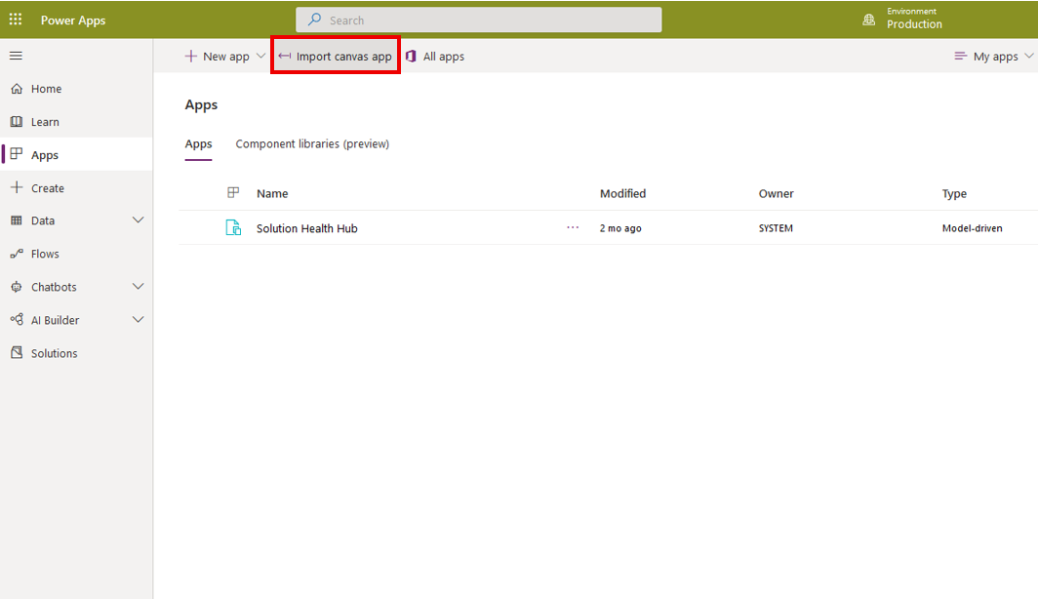
Package Import
1
Choose Import canvas app in make.powerapps.com or Import in aka.ms/flow
Microsoft Confidential

Slide 18
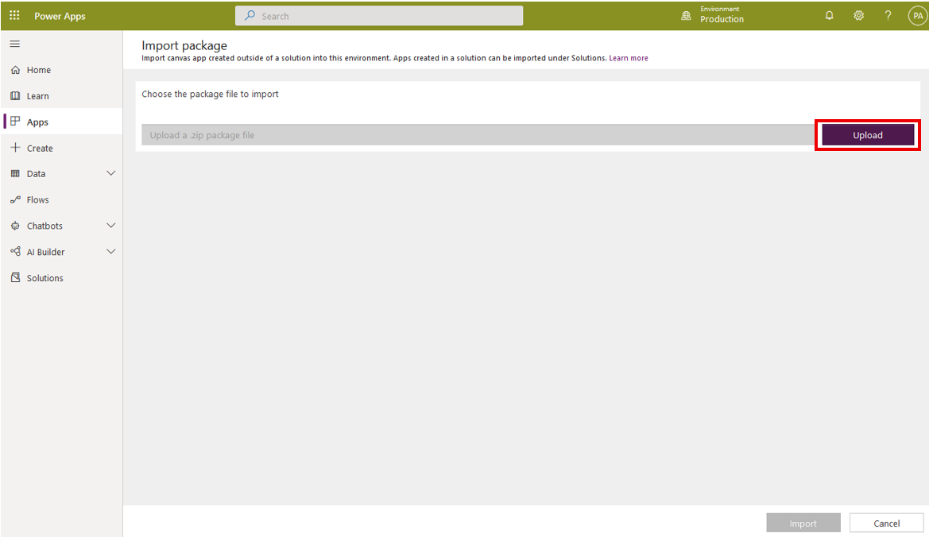
Package Import
1
Choose Import canvas app in make.powerapps.com or Import in aka.ms/flow
2
Select exported package ZIP file
Microsoft Confidential

Slide 19
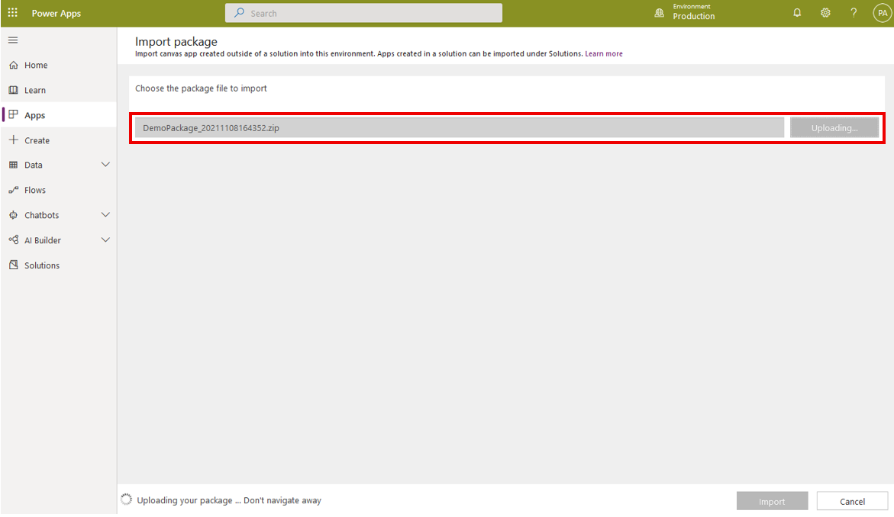
Package Import
1
Choose Import canvas app in make.powerapps.com or Import in aka.ms/flow
2
Select exported package ZIP file
3
Package will be uploaded
Microsoft Confidential

Slide 20
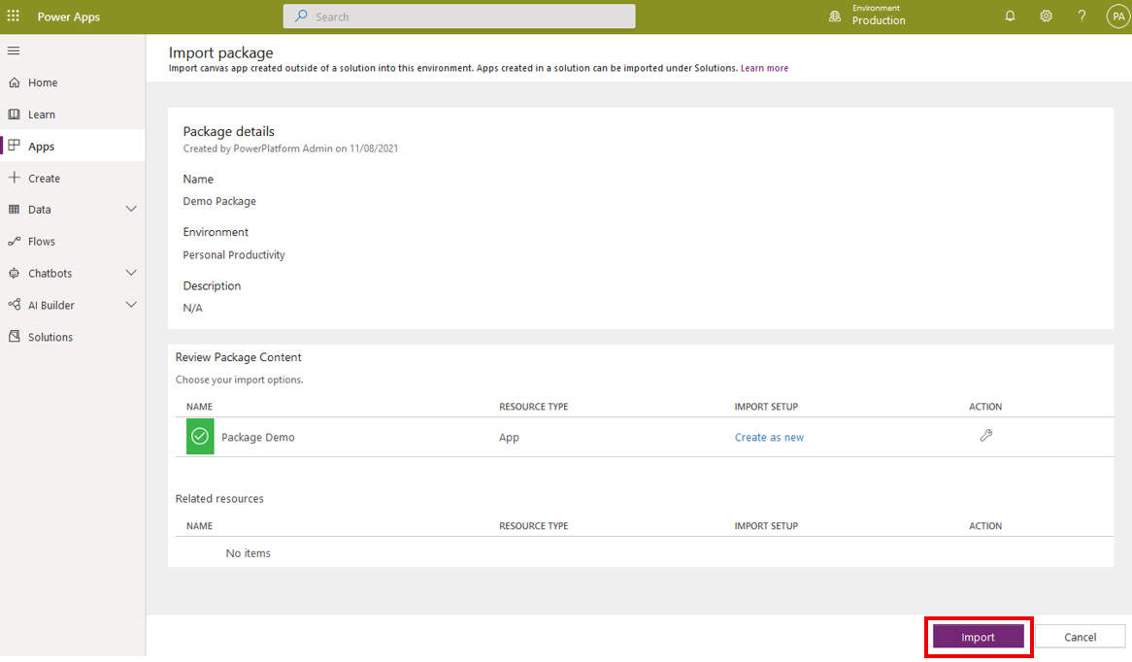
Package Import
1
Choose Import canvas app in make.powerapps.com or Import in aka.ms/flow
2
Select exported package ZIP file
3
Package will be uploaded
4
Set import setup actions and click Import
Microsoft Confidential

Slide 21
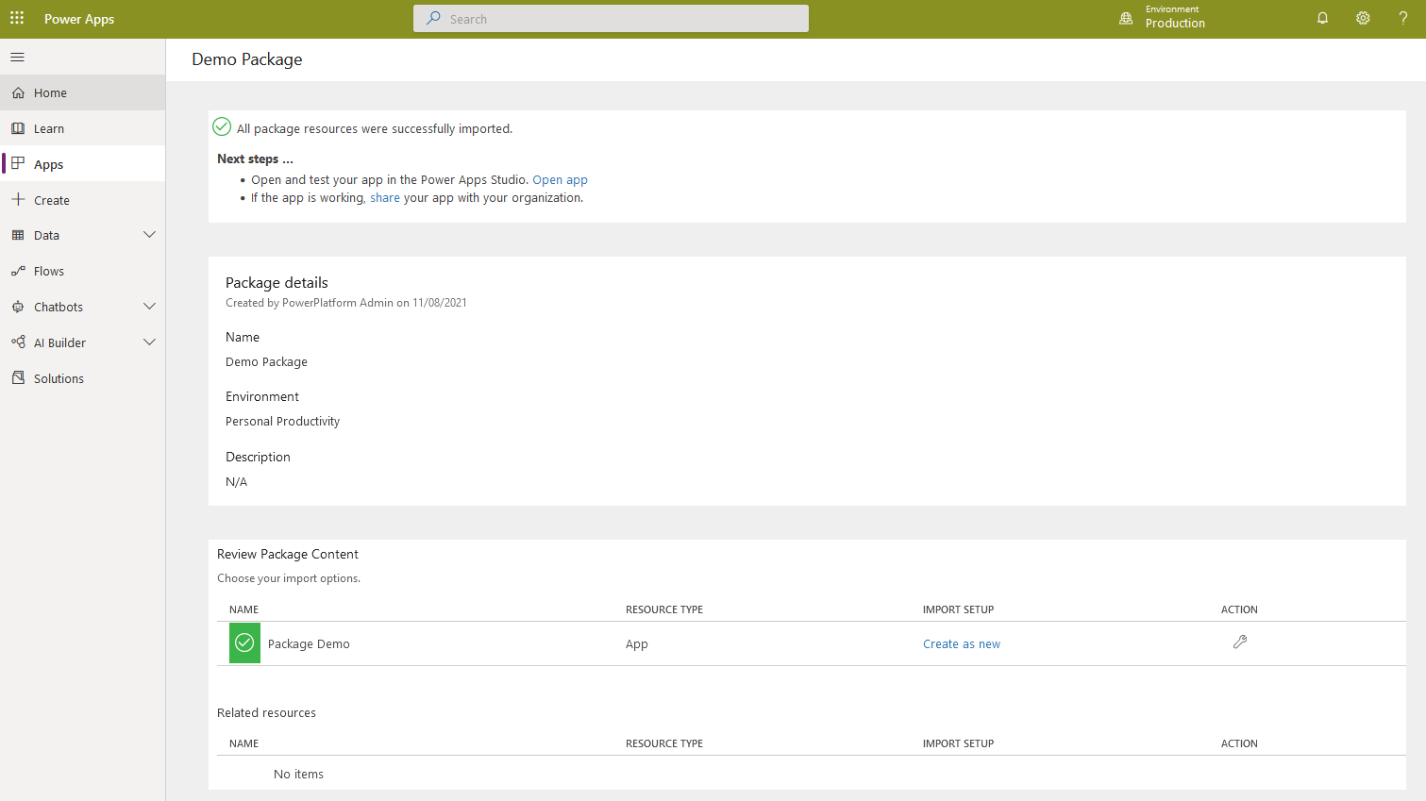
Package Import
1
Choose Import canvas app in make.powerapps.com or Import in aka.ms/flow
2
Select exported package ZIP file
3
Package will be uploaded
4
Set import setup actions and click Import
5
Import is done and you can open the app
Microsoft Confidential

Slide 22
Deploy Resources using a Solution

Slide 23
Solutions Concept
Solutions are the mechanism for implementing ALM in Power Apps and Power Automate.
With solutions we can transport Power Platform components from one environment to another or to apply customizations to existing apps.
Can contain one or more apps and flows as well as other components such as site maps, entities, processes, web resources, option sets, and more
Some components are nested within other components, for example, an Dataverse table contains forms, views, charts, fields, entity relationships, messages, and business rules.
Microsoft Confidential

Slide 24
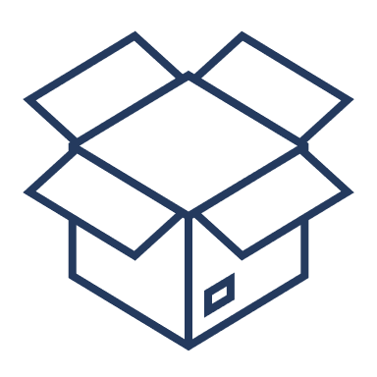
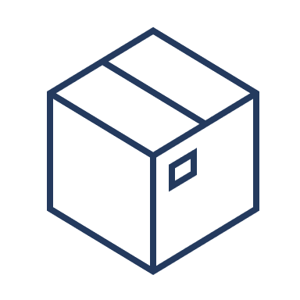
Two types of Solutions
Used in development environments while you make changes to your application
No restrictions on what can be added, removed, or modified
Can be exported as unmanaged or managed
Should be checked into your source control system
You can’t delete its components by uninstalling the solution
UNMANAGED
Complete solution that is intended to be distributed and installed
Components can’t be added or removed
Cannot be exported
Some changes can be done to components if explicitly allowed using managed properties
When a managed solution is deleted (uninstalled), all the customizations and extensions included with it are removed.
MANAGED
Microsoft Confidential

Slide 25
Solution Lifecycle
Create
Author and export unmanaged solutions
Update
Create updates to a managed solution that are deployed to the parent managed solution
You can't delete components with an update
Upgrade
Upgrade an existing managed solution
Involve rolling up (merging) all patches to the solution into a new version of the solution
Will delete components that existed but are no longer included in the upgraded version
You can choose to upgrade immediately or to stage the upgrade so that you can do some additional actions prior to completing the upgrade
Patch
Contains only the changes such as adding or editing components and assets.
Use patches when making small updates (similar to a hotfix)
You can't delete components with a patch.
Microsoft Confidential

Slide 26
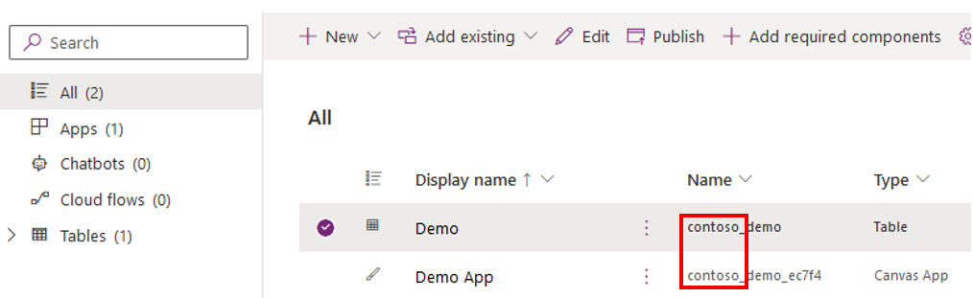
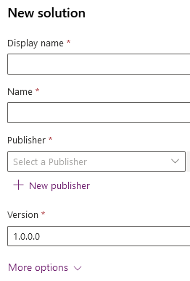
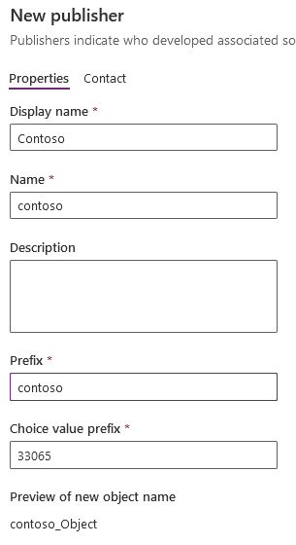
Solution Publisher
The publisher of a solution where a component is created is considered the owner of that component.
Owner controls what changes other publishers of solutions including that component are allowed to make or restricted from making
Every solution has a publisher, you should create your own publisher rather than use the default. Publisher is specified when you create a solution.
It is possible to move the ownership of a component from one solution to another within the same publisher but not across publishers.
A solution publisher includes a prefix which is a mechanism to help avoid naming collisions.
Microsoft Confidential

Slide 27
Solution Dependencies
Because of the way that managed solutions are layered, some managed solutions can be dependent on solution components in other managed solutions.
Solution publishers can take advantage of this to build solutions that are modular.
You may need to install a “base” managed solution first, and then you can install a second managed solution that will further customize the components in the base managed solution.
The second managed solution depends on solution components that are part of the first solution.
The system tracks these dependencies between solutions. If you try to install a solution that requires a base solution that isn’t installed, you won’t be able to install the solution.
Microsoft Confidential

Slide 28

Demonstration
Create Solution with Power App, Flow and Table
Demo the following:
Open make.powerapps.com
Select Contoso Production environment
Create new solution named Contoso Solution and create new publisher named Contoso
Create canvas app, flow and table to solution
Notes:
Consider demoing the following:
1. Open make.powerapps.com
2. Select Contoso Production environment
3. Create new solution named Contoso Solution and create new publisher named Contoso
4. Create canvas app, flow and table to solution
##########

Slide 29
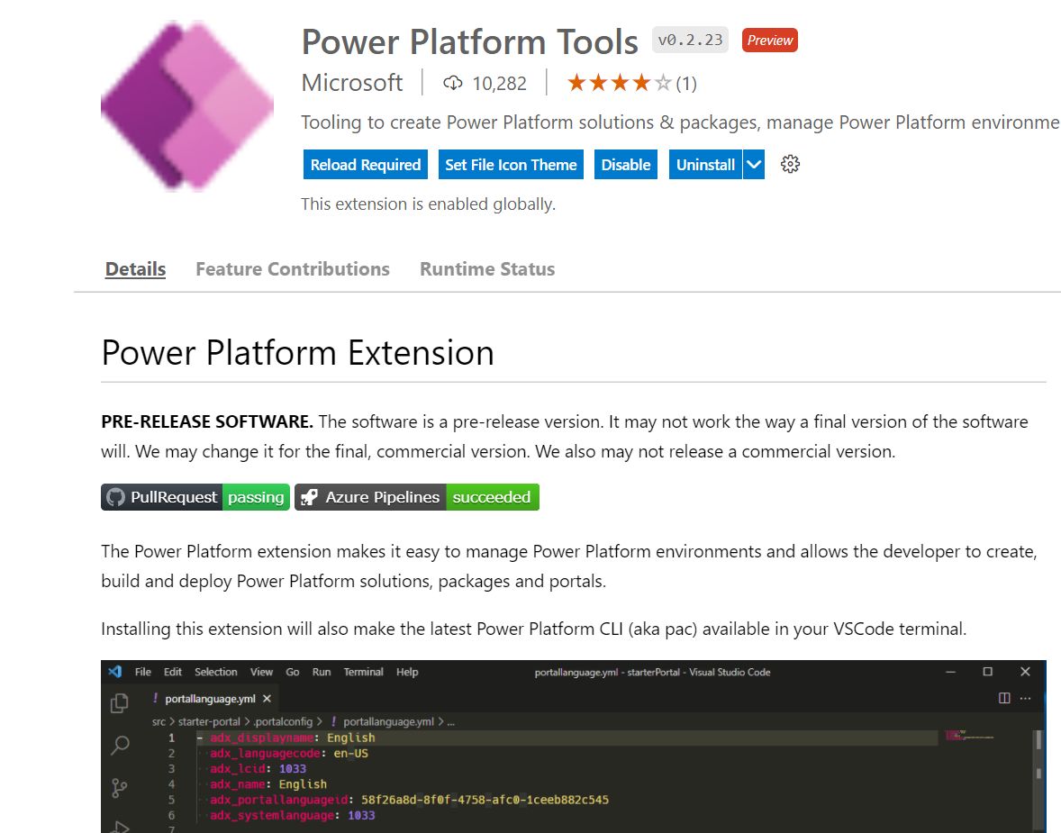
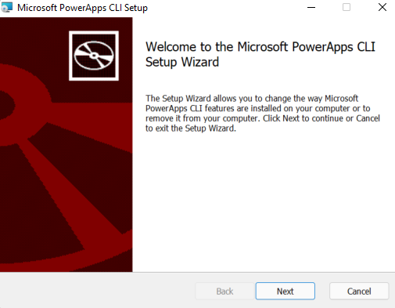
Power Platform CLI
Tools you can use to perform various operations in Microsoft Power Platform related to environment lifecycle, authentication, and work with Microsoft Dataverse environments, solution packages, portals, code components, and so on.
You can use either of the following ways to install Microsoft Power Platform CLI:
Visual Studio Code extension
Standalone MSI installation
Microsoft Confidential

Slide 30
Power Platform CLI – Common Commands
Command | Description
Admin | Commands for environment lifecycle features
Auth | Commands to authenticate to Dataverse
Canvas | Commands for working with canvas app source files
Org | Commands for working with Dataverse environments
Package | Commands for working with solution packages
Paportal | Commands for working with Power Apps portals (Preview)
PCF | Commands for working with Power Apps component framework
Plugin | Command to create a plug-in project
Solution | Commands for working with Dataverse solution projects
Telemetry | Manages the telemetry settings
Microsoft Confidential

Slide 31
Demonstration
Create Solution with Power App, Flow and Table
Demo the following:
Install Power Platform CLI https://aka.ms/PowerAppsCLI
Open CMD and run following command to login using MOD admin creds into Contoso Production environment (replace EnvironmentUrl with correct environment which is like this https://org1234566.crm4.dynamics.com)
pac auth create -u {EnvironmentURL}
Export Contoso Solution to C:\Temp by running the following command
pac solution export –n ContosoSolution –p C:\Temp -m
Notes:
Consider demoing the following:
1. Install Power Platform CLI https://aka.ms/PowerAppsCLI
2. Open CMD and run following command to login using MOD admin creds into Contoso Production environment (replace EnvironmentUrl with correct environment which is like this https://org1234566.crm4.dynamics.com)
pac auth create -u {EnvironmentURL}
3. Export Contoso Solution to C:\Temp by running the following command
pac solution export –n ContosoSolution –p C:\Temp -m
##########

Slide 32
Power Platform Pipelines

Slide 33
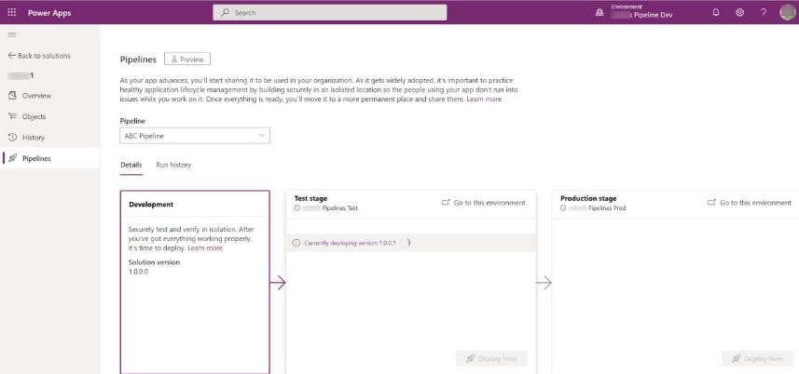
What are Pipelines in Power Platform
Pipelines in Power Platform aim to democratize application lifecycle management (ALM) for Power Platform and Dynamics 365 customers.
Pipelines provide an easy and approachable method for all makers, admins, and developer to do:
ALM automation
Continuous integration (CI)
Continuous delivery (CD)
Overview of pipelines in Power Platform - Power Platform | Microsoft Learn
Microsoft Confidential
Notes:
Pipelines significantly reduce the effort and domain knowledge previously required to realize the ROI from adopting healthy, automated ALM processes within your team or organization.
Admins easily configure automated deployment pipelines in minutes rather than days or weeks.
Makers have an intuitive user experience for easily deploying their solutions.
Professional developers can (optionally) run pipelines using their preferred tools such as the Power Platform command line interface (CLI).

Slide 34
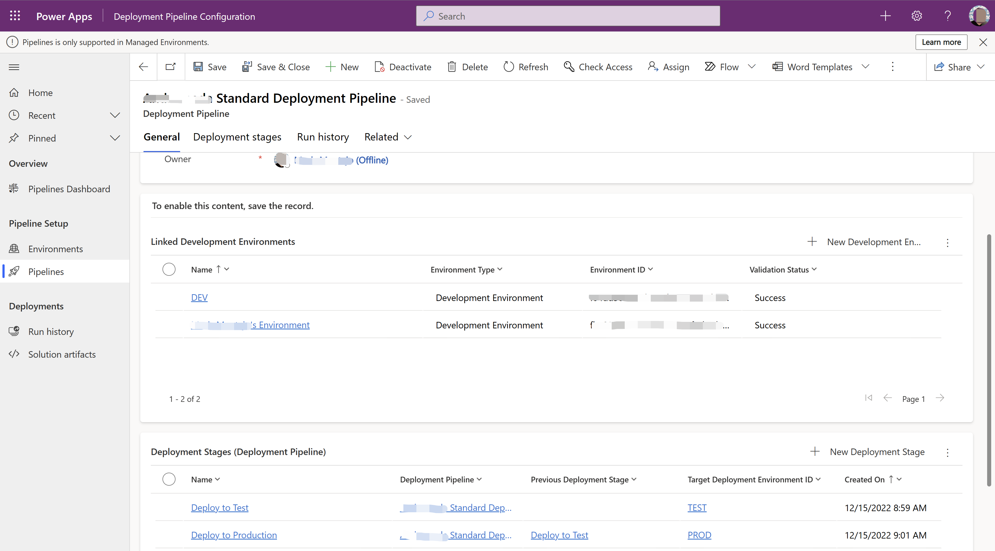
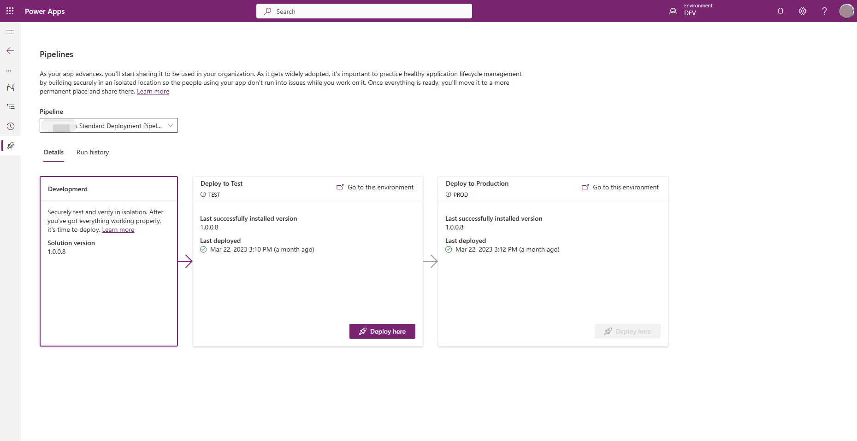
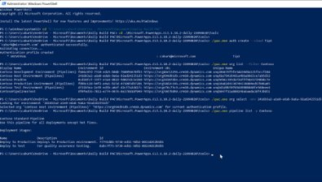
Pipelines simplify ALM for ALL makers
Setup Pipeline in < 2 min
Initiate automated deployments
Run pipelines via CLI
Admins
Citizen developers
Developers
Microsoft Confidential
Notes:
Admins centrally manage and govern pipelines
Pipelines enable admins to centrally govern citizen-led and pro-dev-led projects at scale with less effort. Admins set up the appropriate safeguards that govern and facilitate solution development, testing, and delivery across the organization. Other admin benefits include:
Lower total cost of ownership:
Pipelines significantly improve maker, developer, and admin productivity. Pipelines enable your business solutions to come to market faster, with higher quality, through a safe and governed process.
Minimal effort to implement custom-tailored change management processes across your organization or team.
Save time and money:
The system handles the heavy lifting and ongoing maintenance so you don't have to.
Scale ALM at your own pace:
Regardless of where you're at in your ALM journey, you can extend pipelines to accommodate your evolving business needs. We aim for this upward transition to be as seamless and effortless as possible. More information: Microsoft Power Platform CLI
Achieve compliance, safety, monitoring, and automation goals with:
Customizations and audit logs saved automatically and are easily accessible.
Out-of-the-box analytics provides better visibility within a central location.
The ability to create your own reports from within the pipelines app. More information: Reporting overview for model-driven apps
Makers run preconfigured pipelines
Once pipelines are in place, makers can initiate in-product deployments with a few clicks. They do so directly within their development environments. Other benefits to makers include:
No prior knowledge of ALM processes or systems required. Citizen developers often view pipelines as a guided change management process.
Solution deployments are prevalidated against the target environment to prevent mistakes and improve success rates. For example, missing dependencies and other issues are detected before deployment and makers are immediately guided to take the appropriate action.
Connections and environment variables are provided upfront and validated before the deployment begins.
This helps ensure applications and automation are deployed without needing manual post-processing steps, and are connected to the appropriate data sources within each environment.
Admins can even preconfigure certain connections that will be used.
Developers can use the same pipelines
Professional developers are more productive with pipelines now handling the complex background operations. Developers can tell the system what they want to accomplish instead of executing the various underlying tasks necessary to accomplish the same goal. Using the Power Platform CLI, developers can:
List pipelines to view pertinent details such as which stages and environments are ready to deploy their solutions to.
Deploy a solution with a single command:
With pipelines, developers simply provide the required parameters and the system orchestrates all the end-to-end deployment operations in compliance with the organizational policies.
No need to connect to multiple environments, export solutions, download solution files, manually create connections and populate deployment settings files, import solutions, or handle various other tasks that were required previously.

Slide 35
Licensing Required to Use Pipelines?
No pipelines specific enforcement will be added until later in 2023.
Standalone licenses won't be required to use developer or trial type environments in pipelines.
When pipelines standalone licensing is enforced, end users within any production environment(s) linked to pipelines will require a standalone license for either Power Apps, Power Automate, or Dynamics 365. Makers generally won't require a standalone license unless they're also an end user.
Environment Purpose | Environment Type | Standalone license required
Host | Production | No
Development | Developer | No
QA/Test | Developer | No
Production | Production | Yes
Microsoft Confidential

Slide 36
Set up pipelines in Power Platform
Prerequisites
Four environments are recommended, but you can use as few as three Power Platform environments to create a pipeline.
All environments used in pipelines must have a Microsoft Dataverse database.
Microsoft Dataverse for Teams environments aren't currently supported for use with pipelines.
You must have a Power Platform administrator or Dataverse system administrator role.
Setup
Choose environment for pipelines – four are recommend, example, Host, Dev, QA, Production.
Install the pipelines application in your host environment
Configure a deployment pipeline
Grant access to edit or run pipelines – two security roles come with the Pipelines app.
Share pipelines with makers
Share pipelines with administrators
Centrally manage and monitor deployments
Microsoft Confidential
Notes:
When you installed the Power Platform pipelines application, two security roles were added:
Deployment Pipeline User: Has privileges to run pipelines that have been shared with them.
Deployment Pipeline Administrator: Has full control over all pipeline configuration, without needing system administrator security role membership.

Slide 37
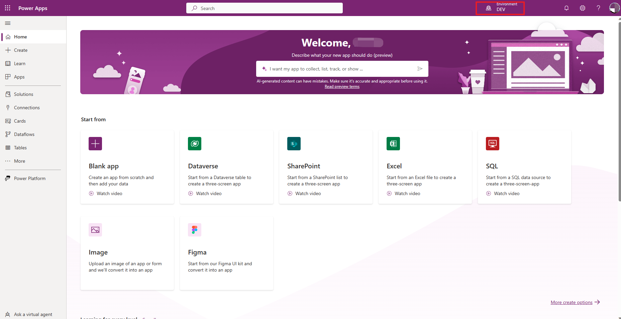
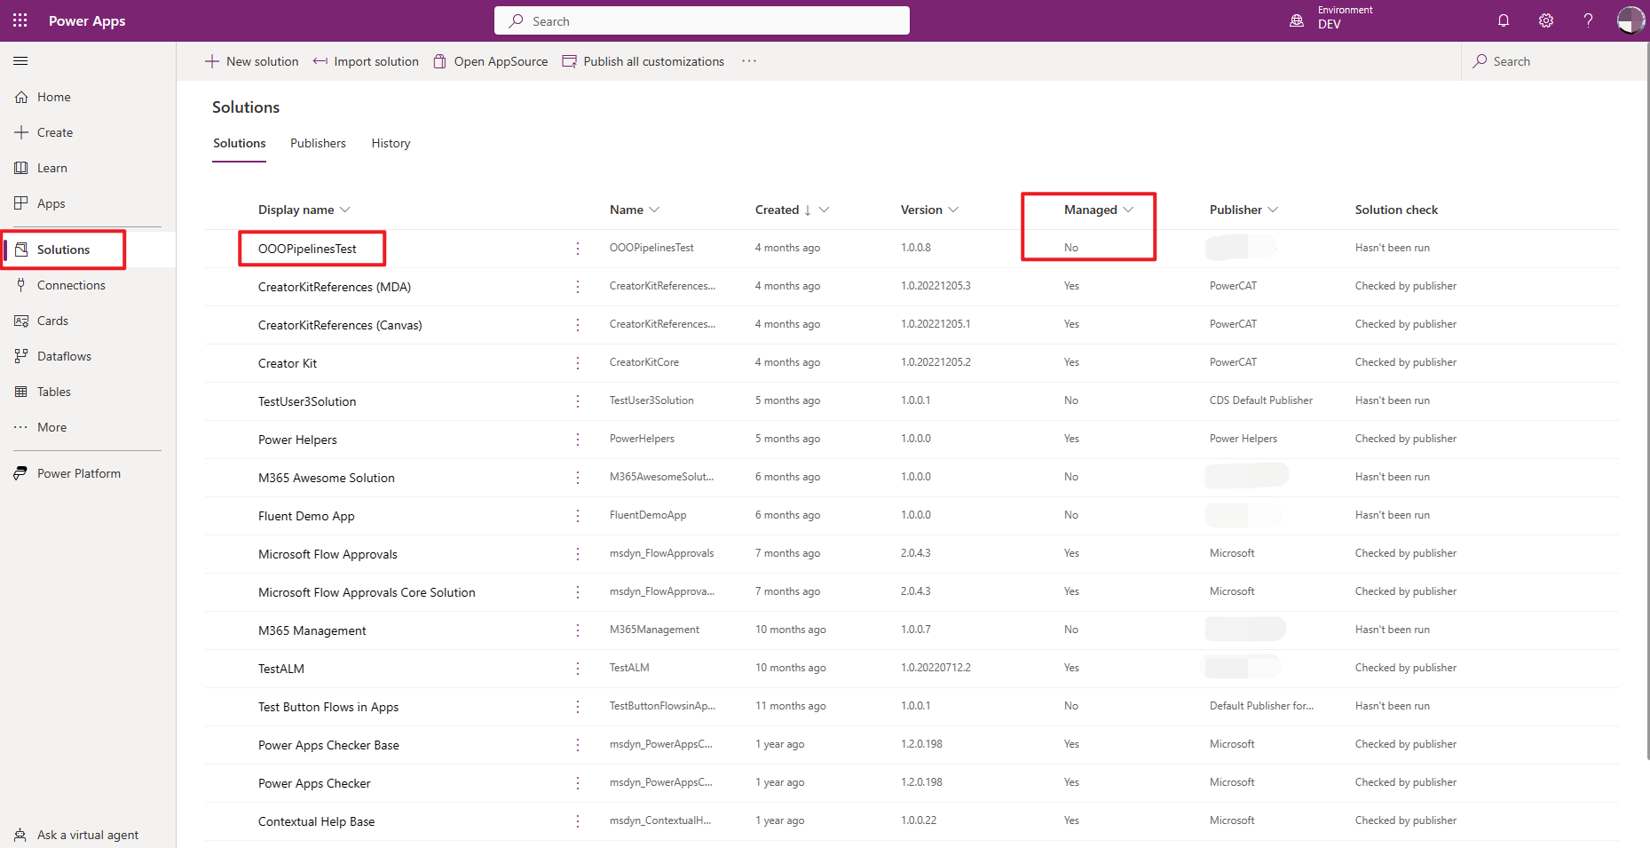
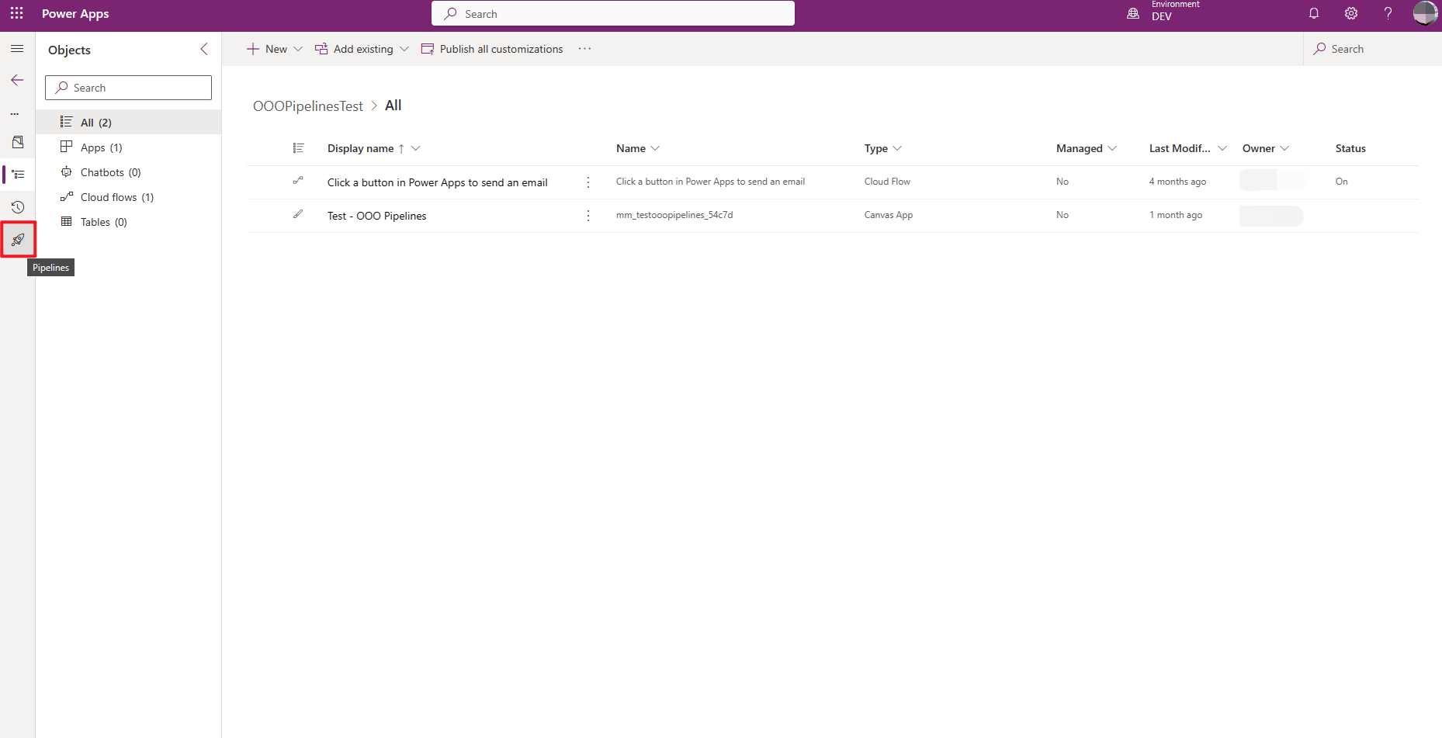
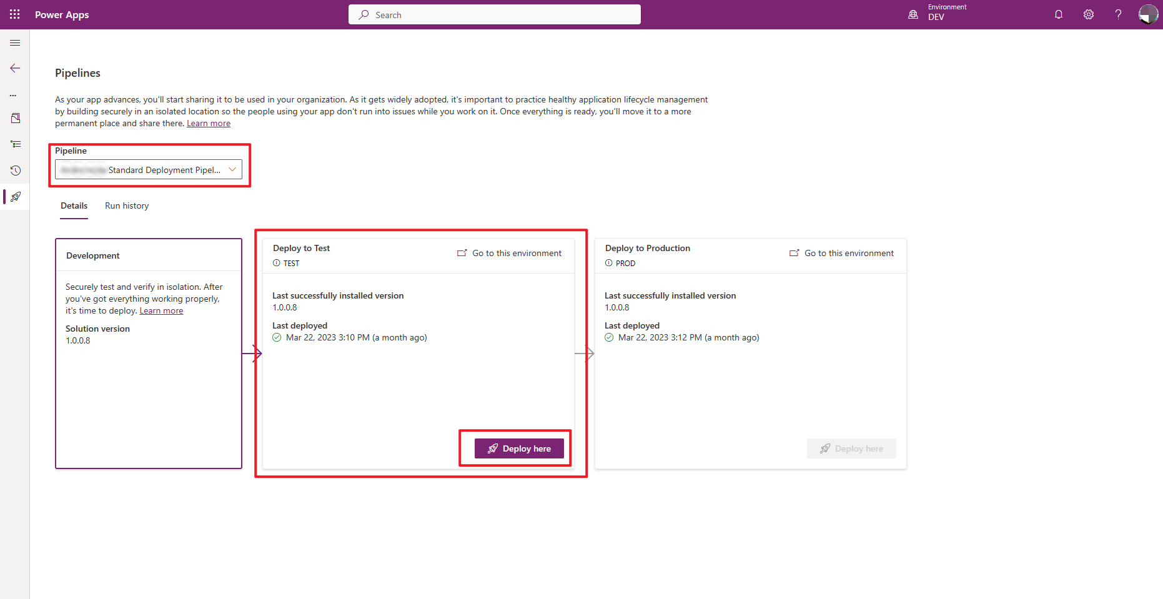
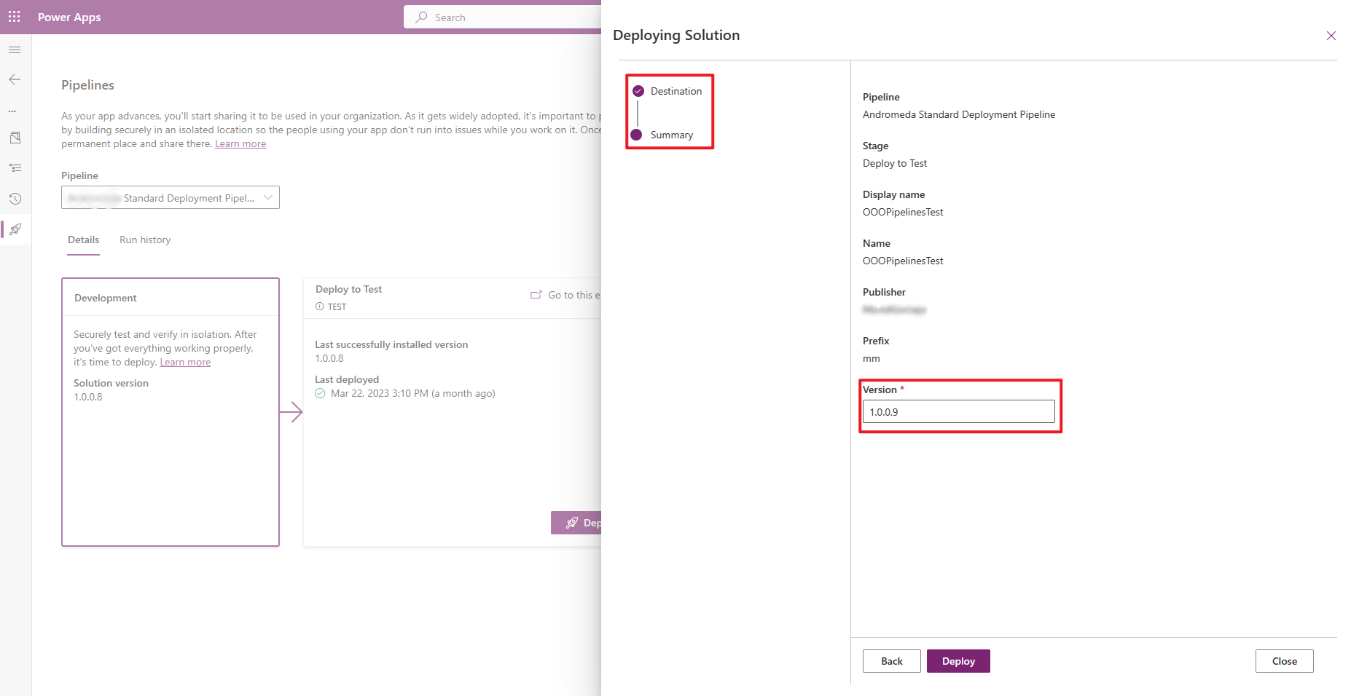
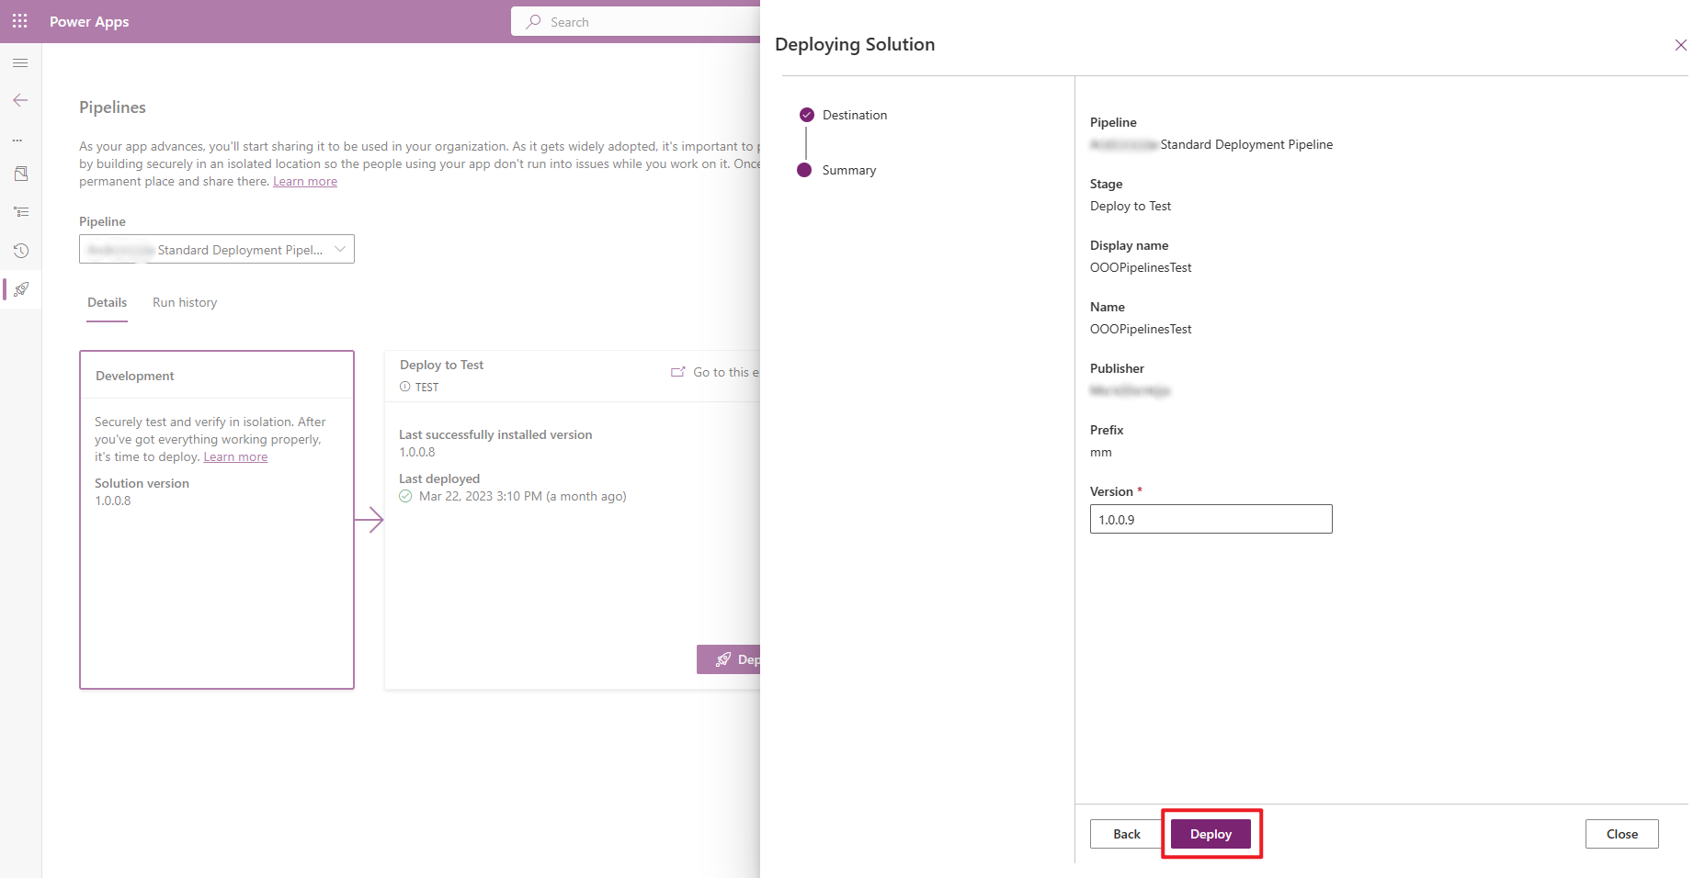
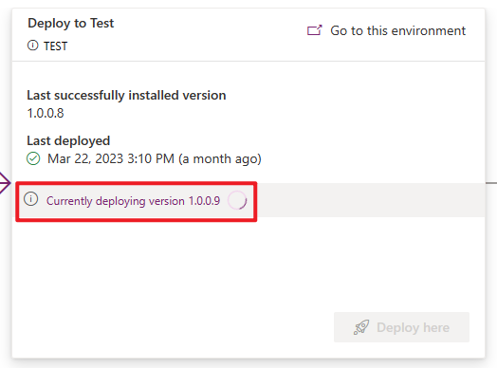
Run Pipeline
1
Sign into a Power Platform environment using Power Apps or Power Automate
2
Go to Solutions and create or select an unmanaged solution
3
Once in a solution, select Pipelines from left navigation menu
4
Select the stage to deploy to, such as Deploy to Test, select Deploy here, and then select Next on the right pane
5
Configure connection references or environment variables if these exist
6
Select Deploy. This initiates an automated deployment to target environment
Microsoft Confidential
Notes:
Step 4 notes - This initiates validation of the solution against the test environment. This validation can also be referred to as “pre-flight” checks. Missing dependencies and other common issues are checked that might cause a deployment to fail.

Slide 38
Power Platform Build Tools for Azure DevOps

Slide 39
Power Platform Build Tools for Azure DevOps
Is a collection of Power Platform–specific build tasks that eliminate the need to manually download custom tooling and scripts to manage the application lifecycle of apps built on Power Platform
Initiate Getting started, faster
Build Build and walk away
Release Automated, predictive, repeatable
Create
branch
Export
unmanaged
solution
Unpack
solution
Check in
to source
Run unit test for .NET
and TS/JS
Pack source
code from
repo
Run solution
checker
Import
solution
to build
Increment
version
Export as
managed
solution
Import
solution
to target
Migrate
config
data
Run
integration
test
Run
functional
test
Provision
environment
Deploy
dependencies
Pack Solution
from repo
Import
solution
Initial pipelines
Instantiates pristine development environments
Check solutions into source control
Build pipeline automates manual steps. Removes the need to manually export/import solutions and config data.
Automated release pipeline removes manual steps. Faster deployment becomes the new standard
Microsoft Confidential

Slide 40
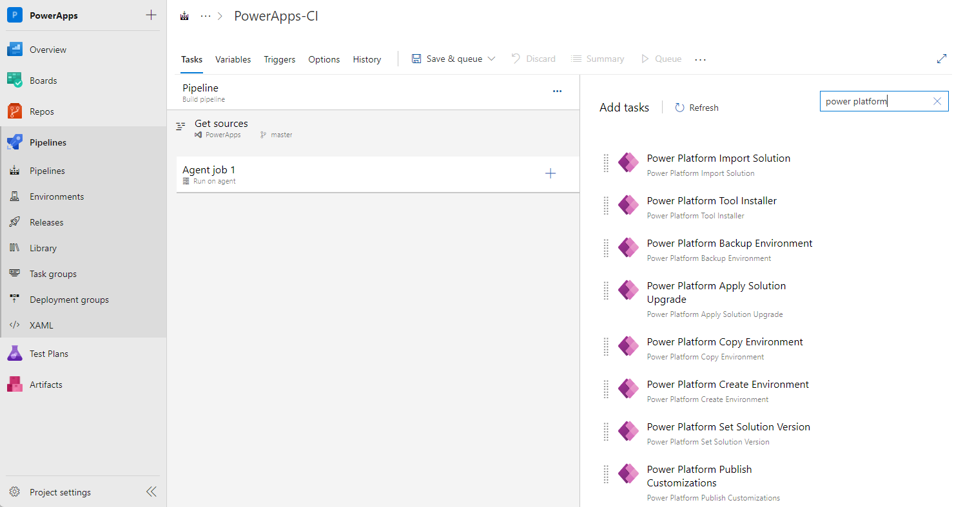
Get Power Platform Build Tools
Power Platform Build Tools can be installed into your Azure DevOps organization from Azure Marketplace
After installation, all tasks included will be available to add into any new or existing pipeline. You can find them by searching for "Power Platform."

Slide 41
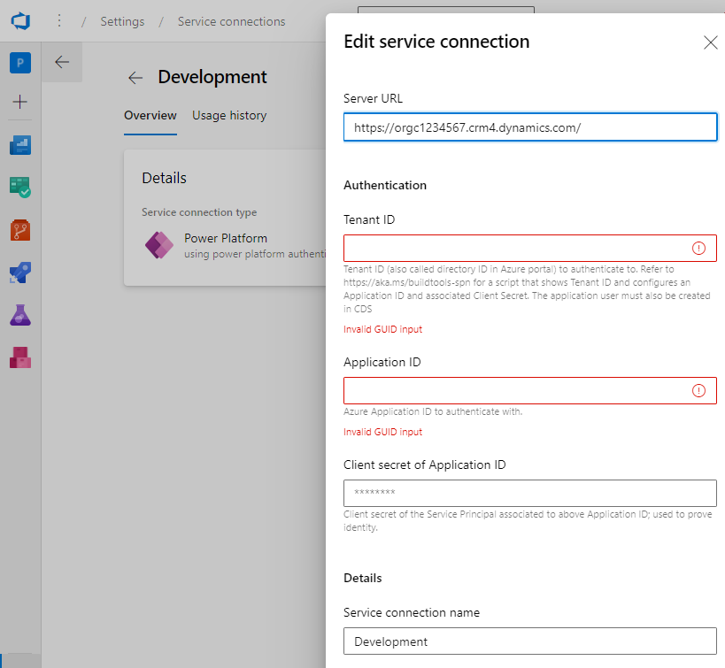
Connection to Power Platform environments
To interact with the Power Platform environment, a connection must be established that enables the various build tool tasks to perform the required actions.
Two types of connections are available:
Username/password: Configured as a generic service connection with username and password. Note that username/password does not support multi-factor authentication.
Service principal and client secret: (recommended) This connection type uses service principal-based authentication and supports multi-factor authentication.
To configure a connection using service principal, you must first create an application registration in Azure Active Directory (AAD) with the required permissions and then create the associated Application User in the Microsoft Power Platform environment you want to connect to
Microsoft Confidential

Slide 42
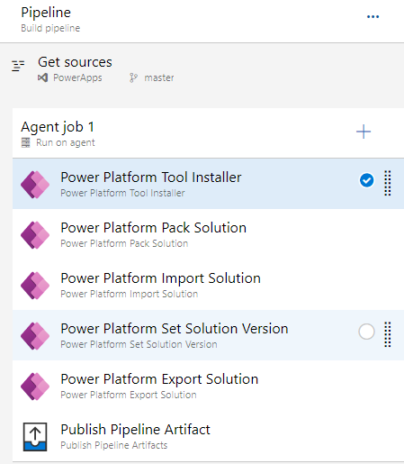
Azure Pipelines
Azure Pipelines automatically builds and tests code projects to make them available to others.
Works with just about any language or project type
Combines Continuous Integration (CI) and Continuous Delivery (CD) to test and build your code and ship it to any target
CI is the practice used by development teams of automating merging and testing code
CD is a process by which code is built, tested, and deployed to one or more test and production environments
The starting point for configuring CI and CD for your applications is to have your source code in a version control system.
Microsoft Confidential

Slide 43
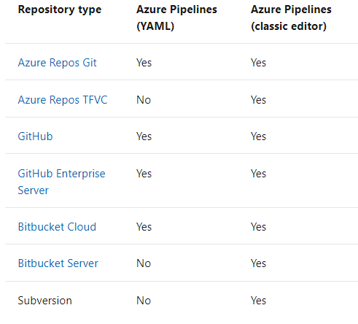
Azure Repos
Azure Repos is a set of version control tools that you can use to manage your code.
Version control systems are software that help you track changes you make in your code over time.
Provides two types of version control:
Git: distributed version control
Team Foundation Version Control (TFVC): centralized version control (should not be used for new projects)
Microsoft Confidential

Slide 44
Power Platform + GitHub

Slide 45
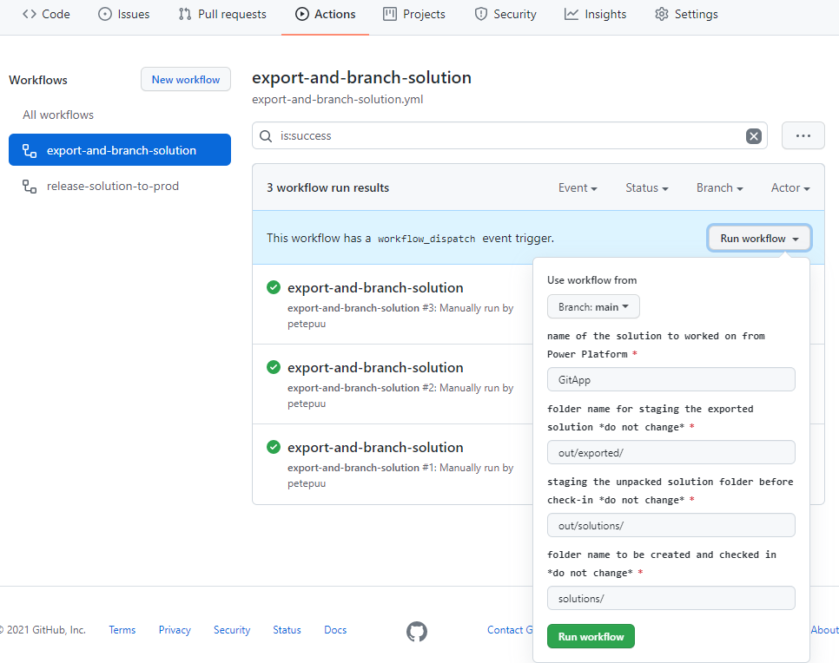
GitHub Actions
Help you automate tasks within your software development life cycle
Event-driven meaning that you can run a series of commands after a specified event has occurred
Actions are defined in workflow definition file (.yml)
Microsoft Confidential

Slide 46
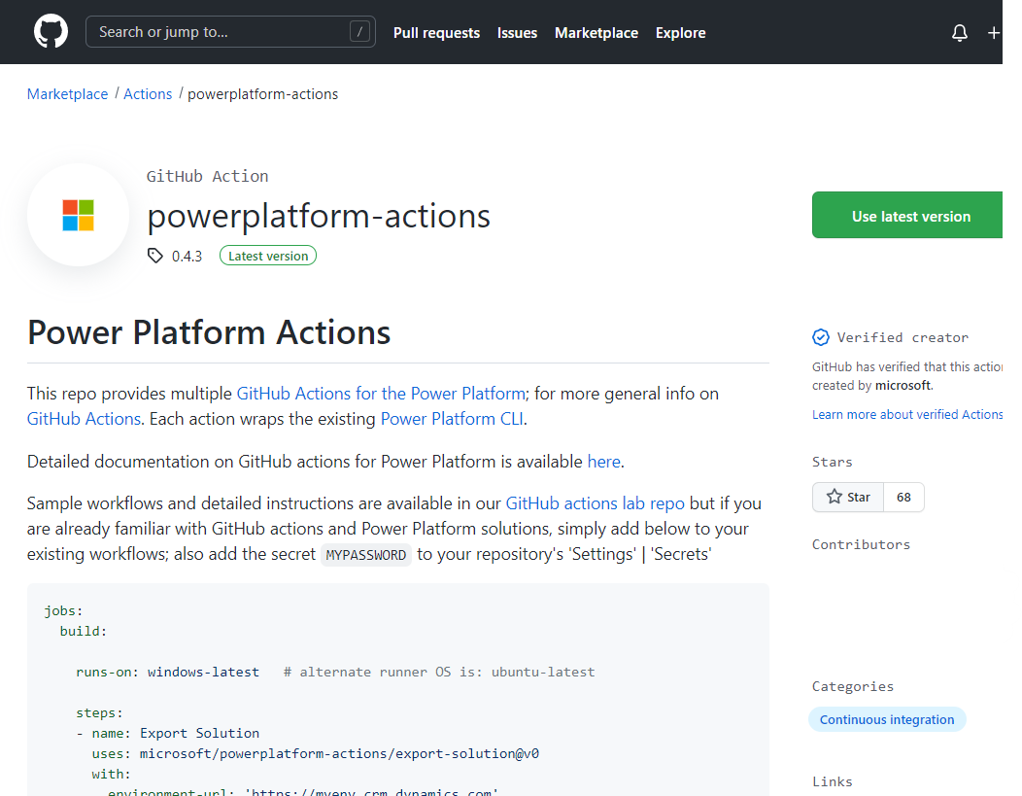
Power Platform + GitHub Actions
Enable developers to build automated software development lifecycle workflows for Power Platform solutions
Are supported only for environments with a database
Similar tools available as in Azure DevOps Build Tools
You can create workflows in your repository to build, test, package, release, and deploy apps; perform automation; and manage bots and other components built on Microsoft Power Platform
GitHub Actions for Microsoft Power Platform can run on both Microsoft Windows agents and Linux agents
https://github.com/marketplace/actions/powerplatform-actions
Microsoft Confidential

Slide 47
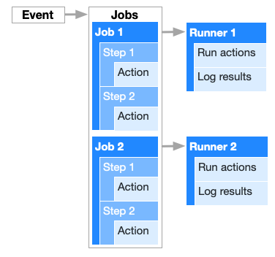
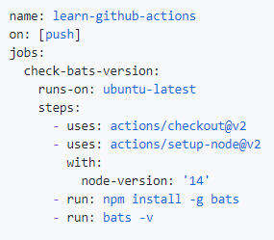
Components of GitHub Actions
Workflows - Automated procedure which can be used to build, test, package, release, or deploy a project on GitHub. Made up of one or more jobs and can be scheduled or triggered by an event
Events - Is a specific activity that triggers a workflow. For example, when someone pushes a commit to a repository or when an issue or pull request is created
Jobs - Set of steps that execute on the same runner. By default, multiple jobs run in parallel but can also configure to run jobs sequentially. For example, a workflow can have two sequential jobs that build and test code where the test job is dependent on the status of the build job.
Microsoft Confidential

Slide 48
Components of GitHub Actions
Steps - An individual task that can run commands in a job. A step can be either an action or a shell command.
Actions - Standalone commands that are combined into steps to create a job. Actions are the smallest portable building block of a workflow. You can create your own actions or use actions created by the GitHub community.
Runners - Is a server that has the GitHub Actions runner application installed. You can use a runner hosted by GitHub, or you can host your own. A runner listens for available jobs, runs one job at a time, and reports the progress, logs, and results back to GitHub.
Microsoft Confidential

Slide 49
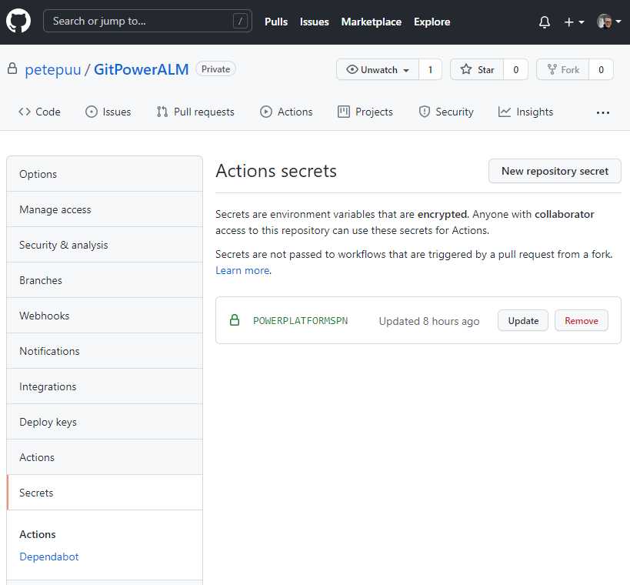
Connection to Power Platform environments
Similar as in Azure DevOps Build Tools you have two options to connect Power Platform environments:
Username/password: Configured as a generic service connection with username and password. Note that username/password does not support multi-factor authentication
Service principal and client secret: (recommended) This connection type uses service principal based authentication and supports multi-factor authentication.
Microsoft Confidential

Slide 50
Questions?

Slide 51
Lab 1, 2 and 3
Lab Description
Lab 1. Deploy Resources Between Environments Using a Package Lab 2. Deploy Resources Between Environments Using a Solution
Lab 3. Deploy solution using Power Platform Pipelines
Notes:
Link to lab: https://labondemand.com/LabProfile/
##########

Slide 52
Microsoft

